Slide 1
Unit 5
Limitations of Algorithmic Power and Coping with them

Slide 2
Introduction
Till now we have seen algorithms for solving variety of different problems
Some problems cannot be solved by any algorithm.
Other problems can be solved algorithmically but not in polynomial time.

Slide 3
Lower-Bound Arguments
The efficiency of any algorithm can be looked at in two ways.
- Establish its asymptotic class and see where this class stands with respect to the hierarchy of efficiency classes. (eg: selection sort – n² generating permutations - n! and so on)
It is like Comparing apple with orange and finding which is the best.
- Ask how efficient the algorithm is with respect to other algorithms for the same problem.

Slide 4
Lower-Bound Arguments
When the efficiency of an algorithm is ascertained with respect to other algorithms for the same problem, it is often better to know the best possible efficiency any algorithm solving the problem may have.
This is known as lower bound.
The lower bound can tell how much improvement we can hope to achieve in the quest for a better algorithm for the problem in question

Slide 5
Decision Trees
It is a device that allows comparing the performance of algorithms such as sorting and searching.
Each internal node of a binary decision tree represents a key comparison indicated in the node.
The node’s left subtree contains the information about subsequent comparisons made if the condition is satisfied.
Each leaf represents a possible outcome of the algorithm’s run on some input of size n.

Slide 6
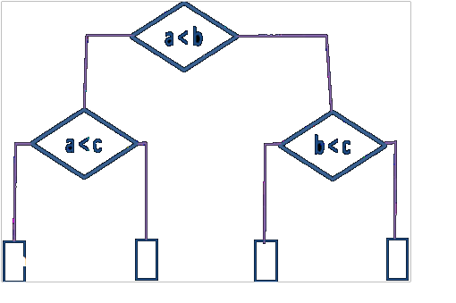
Decision Trees
Finding the minimum of three numbers
a
c
b
c
The number of leaves can be greater than the number of outcomes because the same outcome can be arrived through a different chain of comparisons.
The number of leaves must be at least as large as the number of possible outcomes.

Slide 7
Decision Trees
The number of comparisons in worst case is equal to the height of the tree.
The idea is that a tree with a given number of leaves, which is dictated by the number of possible outcomes, has to be tall enough to have that many leaves.
For any binary tree with l leaves and height h
h ≥ log ₂ l

Slide 8
Decision Trees for Sorting Algorithms
Decision Trees for Sorting Algorithms
Sorting algo is comparison-based.
The basic operation is comparison except for binary insertion sort.
The outcome of a sorting algo can be interpreted as finding a permutation of element indices of an input list that puts the list’s elements in ascending order.

Slide 9
Decision Trees for Sorting Algorithms
Three element insertion sort
Binary Search

Slide 10
P, NP and NP complete

Slide 11
Definition 1
We say that an algorithm solves a problem in polynomial time if its worst case time efficiency belongs to O(p(n)) where p(n) is a polynomial of the problem’s input size n. (Note that since we are using big-oh notation here, problems solvable in polynomial time as well.)
Problems that can be solved in polynomial time are called tractable , problems that cannot be solved in polynomial time are called intractable.

Slide 12
Definition 2
Class P is a class of decision problems that can be solved in polynomial time by (deterministic) algorithms. This class of problems is called polynomial .

Slide 13
Definition 3
A nondeterministic algorithm is a two stage procedure that takes as its input an instances I of a decision problem and does the following.
Nondeterministic(“guessing”) stage : An arbitrary string S is generated that can be thought of as a candidate solution to a given instance of I.
Deterministic(“verification”) stage : A determinstic algorithm takes both I and S as its input and outputs yes if S represents a solution to instance I.(If S is not a solution to instance I, the algorithm is either returns no or is allowed not to halt at all).

Slide 14
Definition 4
Class NP is the class of decision problems that can be solved by nondeterministic polynomial algorithms. This class of problems is called nondeterministic polynomial.
Most decision problems are in NP.First of all, this class includes al the problems in P:
P⊆NP

Slide 15
Definition 5
A decision problem D1 is said to be polynomially reducible to a decision problem D2 if there exists a function t that transforms instances of D1 to instances of D2 such that
t maps all yes instances of D1 to yes instances of D2 and all no instances of D1 to no instances of D2
t is computable by a polynomial time algorithm.

Slide 16
Definition 6
A decision problem D is said to be NP-complete if
1. it belongs to class NP
2. every problem in NP is polynomially reducible to D

